Slide 1
Cost of quality and TQM
Quality:
Defined as the totality of features and characteristics of a product or service that bear on its ability to satisfy stated or implied needs.”
Includes: Form
Fix
Function
Reliability
Consistency

Slide 2
Classification of quality cost
Cost of Conformance
Cost of non conformance
Cost of lost opportunity

Slide 3
COST OF CONFORMANCE
Prevention Cost: Trying to prevent failure from happening. Cost incurred before the base activity on ensuring that the base activities will be dine right first.
Appraisal Cost: the cost incurred to determine conformance with quality standards.

Slide 4
Cost of Non Conformance
Cost of Internal Failure: cost of correcting Products or services which do not meet quality standards prior to delivery to the customers.
Cost of External Failure: It occurs when product or service is offered to the customers and found defective.
Cost of exceeding Requirements: Cost incurred for providing information which are unnecessary or unimportant for which no know requiremt has been established.

Slide 5
Cost of lost opportunity
Lost revenue resulting from the loss of existing customer, the loss of potential customers and the lost business growth arising from the failure to deliver products and services at the required quality standards.

Slide 6
Optimization of Quality Cost
Quality cost reduction is achieved in following two stages:
When prevention costs are increased to pay for the right kind of system engineering work in quality control, a reduction will occur in rejection
a reduction in defective output will have a positive effect on appraisal cost because defect reduction means a reduced need for routine inspection and test activity.

Slide 7
QUALITY COST REPORTING

Slide 8
Analysis of Quality Cost
Internal Failure cost/ Direct Labor
Total Failure Cost/ Manufacturing Costs
Total Quality Cost/ Net Sales

Slide 9
Total Quality Management
According to Richard J. Schonberger” the total quality Management is the set of concepts and tools for getting all employees focused on continuous improvement, in the eyes of the customer”

Slide 10
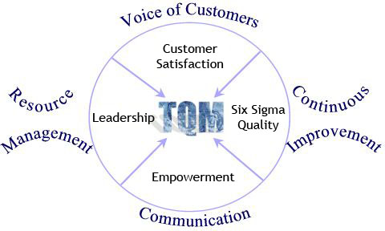

Slide 11
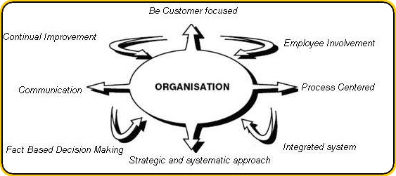

Slide 14
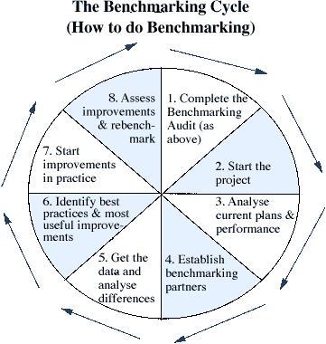

Slide 15
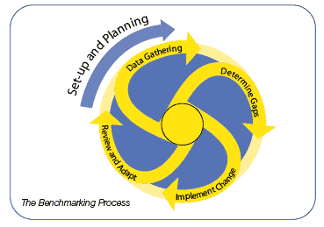

Slide 17
A man attended an interview for a job. Along the corridor, he picked up a piece and threw it into a dustbin. The interviewer passed by and saw it. This man got the job. Moral of the story: Live with good habits, and you will be recognized

Slide 18
A small boy worked as an apprentice in a bicycle shop. A man sent a bicycle for repair. After repairing the bicycle, this boy cleaned up the bicycle and it looked like a new one. Other apprentices laughed at him for doing redundant work. The second day after the owner claimed the bicycle back, this boy was pinched and offered a job. Moral of the story : 1.Go the extra mile to be successful. 2. Doing more gains more & Doing less loses more

Slide 19
A shop is always brightly lit up. Someone asked : “What brand of bulb are you using ? It is so lasting.” The shop owner replied : “Our bulbs blew out frequently. We replaced them once a bulb blew out.” Moral of the story: To brightening up everyday life : Endeavor to abandon unwholesome states of mind and make an effort to encourage wholesome states to grow.

Slide 20
The owner of a farm asked his child to work everyday at the farm. His friend said to him : “ You do not have to make your son work so hard. The crops would grow just as good.” Owner of the farm replied: “ I am not cultivating my crops, but my child.”
Moral of the story: If not cut, jade would not turn into useful ware.

