Slide 1
Business Plan Development

Slide 2
Basics of Entrepreneurship

Slide 3
Critical Success Factors
CSFs are measures of those aspects of firm’s performance that are essential to its competitive advantage and therefore, to its success

Slide 4
SWOT Analysis

Slide 5
Michael Porter Five Forces Model

Slide 6
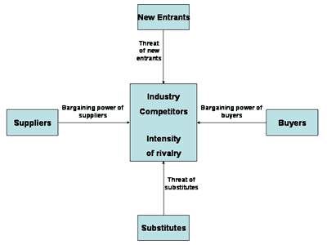
Competitive Environment- Michael Porter’s Five Forces Model

Slide 7
Competitive Environment- Michael Porter’s Five Forces Model
Threat of the entry of new competitors
Existence of Barriers to Entry
Economies of scale
Product differentiation
Brand Equity
Capital requirements
Access to distribution channels
Absolute cost advantages
Government policies

Slide 8
Contd..
The intensity of competitive rivalry Number of Firms and their Relative Market Share, Strengths
Rate of industry growth –Demand conditions
High Fixed cost
Exit barriers
Product Standardization
Informational complexity and asymmetry
Threat of Substitutes

Slide 9
Contd…
Bargaining power of customers:
buyer concentration to firm concentration ratio buyer volume
buyer switching cost relative to firm switching costs
buyer information availability
ability to integrate backward
availability of existing substitute products
buyer price sensitivity
price of total purchase

Slide 10
Contd…
Bargaining power of suppliers
supplier switching costs relative to firm switching costs
degree of differentiation of inputs
presence of substitute inputs
supplier concentration to firm concentration ratio
threat of forward integration by suppliers relative to the threat of backward integration by firms
cost of inputs relative to selling price of the product

Slide 11
Competitive Advantage
Competitive advantage is creating better customer value for the same or lower cost than offered by competitors.
Customer value is the difference between what a customer receives and what customer gives up
Customer realization includes basic product features, service, quality, instructions for use, brand & any factor that is important for customer
Customer sacrifice includes cost, time spent in purchasing & maintenance costs

Slide 12
A firm’s degree of reliance on cost management depends on the nature of its competitive strategy

Slide 13
Generic Strategies & customer value
Cost leadership is to provide same or better value to customers at lower cost than offered by competitors
This strategy increases customer value by minimizing customer sacrifice
Differentiation is to increase customer value by increasing what customer wants

Slide 14
Three Generic Strategies
Cost Leadership: is a competitive strategy in which a firm succeeds in producing products or services at the lowest cost in the industry
Differentiation: is a competitive strategy in which a firm succeeds in developing and maintaining a unique value for the product as perceived by consumers
Focus: selecting or emphasizing a market or customer segment in which to compete.

Slide 15
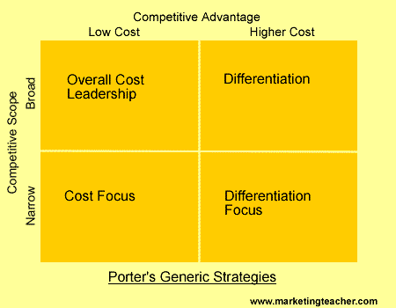

Slide 16
Strategic Positioning
It is the process of selecting optimal mix of three general strategic approaches with an objective of creating sustainable competitive advantage

Slide 17
Leading firms in Selected Benchmarks: Critical Success Factors
Customer Service: FedEx, Amazon.com
Innovation & Product development: Apple, Sony,
Quality: Toyota, IBM
CSR: GE, Johnson& Johnson
Labor Relationships & Employee training: HP, IBM,

Slide 18
Value chain Analysis
It is a tool firms use to identify the specific steps required to provide a competitive product or service to the customer.
Help firms to discover which activity should be outsourced, increase value for the customer at one or more steps of the value chain, which activities are not competitive, where costs can be reduced.

Slide 19
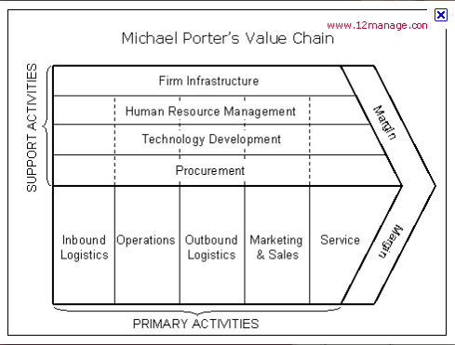

Slide 20
Financial & Non Financial measures of Success – Critical Success Factors
Financial Measures
Sales growth
Earnings Growth
Dividend Growth
Cash flow
Increase in stock price

Slide 21
Non Financial Measures of Success
Market share and growth in market share
Customer service
On time delivery
Customer satisfaction
Brand recognition
High Product Quality
Manufacturing Innovation
Trained Human Resources

Slide 22
Distinctive Aspects of two Competitive strategies
Aspect | Cost Leadership | Differentiation
Strategic target | Broad cross section of the market | Focused of the market
Basis of competitive advantage | Low cost in industry | Unique product or service
Product Line | Limited selection | Wide variety, differentiating features
Production emphasis | Lowest possible cost with high quality and essential product features | Innovation in differentiating products
Marketing emphasis | Low price | Premium price and innovative, differentiating features

Slide 23
Social entrepreneurs
A social entrepreneur recognizes a social problem and uses entrepreneurial principles to organize, create and manage a venture to forge social change.
Unlike business entrepreneurs, they don’t measure performance in profit and returns, but assess success by the impact they have on society
Ashoka Fellow is a nonprofit organization supporting the field of social entrepreneurship. Ashoka was founded by Bill Drayton in 1981 to identify and support leading social entrepreneurs through a Social Venture Capital approach
Social venture capital is a form of venture capital investing that provides capital to businesses deemed socially and environmentally responsible. These investments are intended to both provide attractive returns to investors and to provide market-based solutions to social and environmental issues.

Slide 24
Women Entrepreneurs
Anita Roddick was the founder of The Body Shop, one of the world's most successful retailers of cosmetics and related products

Slide 25
Fabindia - John Bissell
Fabindia is synonymous with the country's handloom couture revolution. The birth of the chain in 1960 marked the beginning of the transformation of traditional Indian fabrics into fashion textiles for apparel and designer home decor. It also pushed traditional Indian weaves to the American market.

Slide 26
Comparison of Prior and Contemporary Business Environment
Manufacturing
 | Prior Business Environment | Contemporary Business Environment
Basis of competition | Economies of scale, standardization | Quality, functionality, customer satisfaction
Manufacturing process | High volume, long production runs, significant levels of in-process and finished inventory | Low volume, short production runs, focus on reducing inventory levels and other non-value added activities and costs
Required Labour skills | Machine-paced, low level skills | Individually and team-paced, high-level skills
Emphasis on quality | Acceptance of a normal or usual amount of waste | Goal of zero defects

Slide 27
Contd..
Marketing
 | Prior Business Environment | Contemporary Business Environment
Products | Relatively few variations, long products life cycles | Large number of variations, short product life cycles
Markets | Largely Domestic | Global

Slide 28
Contd
Management Organizations
 | Prior Business Environment | Contemporary Business Environment
Focus | Financial measures of performance | Non Financial Measures such as quality, customer service, time to delivery
Management organizational structure | Hierarchical, command and control | Network based organization forms, teamwork focus – employee has more responsibility and control, coaching rather than command and control
Management focus | Emphasis on the short term, short term performance measures and compensation, concern for sustaining the current stock price, myopic focus | Emphasis on the long term, focus on critical success factors, commitment to the long term success of the firm including maximising shareholder value

Slide 29
Vishal Talreja – Cofounder Dream A Dream
Empowering children from vulnerable backgrounds by developing life skills,
Today, Dream a Dream partners with six NGOs. Dream a Dream runs structured programs in these partnerships: for development of life skills in these children

Slide 30
India is ninth in the Global Entrepreneurship Monitor (GEM) survey of entrepreneurial countries. It is highest among 28 countries in Necessity based entrepreneurship, while 5th from the lowest in opportunity based entrepreneurship.
India TEA 12.1% China’s average rate of Entrepreneurship has averaged 14.1%.
World Average = 10.6% - Africa Only (15.6%) - Asia Only (11.2%) - Europe Only (6.4%) - North America Only (13.4%) - South America Only (19.2%) - Mid Eastern Only (11.8%)

Slide 31
Mitra Technology -
Owns and manages India’s largest volunteer placement initiative iVolunteer

Slide 32
Entrepreneur of the Year
Narendra Mukumbi

Slide 33
Thank You

