Slide 1
Session 2
EVOLUTION OF MANAGEMENT THOUGHT

Slide 2
Management Theory
Classical Approaches
  Frederick Taylor: Scientific Management (1886)
  Frank and Lillian Gilbreth: Time/motion studies (later 1800s)
  Henri Fayol: 14 Principles of Management (1880s-1890s)
  Max Weber : Bureaucracy (1920s)
Behavioral Approaches
  The Hawthorne Experiment (1927)
  MacGregor’s Theory X and Theory Y (1960)
Quantitative Approaches
Contemporary Approaches
  Ouchi’s Theory Z (1981)
  Contingency Management

Slide 3
Major branches in the classical approach to Management.
Classical Approaches
----------------------------
Assumption: People are rational
Scientific Management
-------------------------
Frederick Taylor
The Gilbreths
Henry Gantt
Bureaucratic Organization
-------------------------
Max Weber
Administrative Principles
--------------------------------
Henry Fayol
Mary Parker Follett
Focuses on the overall organizational system
Focuses on the individual worker’s productivity
Focuses on the functions of management

Slide 4
Scientific Management: Taylor
Frederick W. Taylor (1856-1915)
  Father of “Scientific Management.
    attempted to define “the one best way” to perform every task through systematic study and other scientific methods.
    believed that improved management practices lead to improved productivity.
    Putting the right person on the job with the correct tools and equipment.
    Having a standardized method of doing the job.
    Providing an economic incentive to the worker.
  Three areas of focus:
    Task Performance
    Supervision
    Motivation

Slide 5


Scientific Management
The Gilbreths
Frank Gilbreth used motion pictures
to analyze workers’ motions
Lillian Gilbreth championed protecting workers from unsafe working conditions
Henry Gantt
Focused on control systems for production scheduling (Gantt Chart)

Slide 6
Gantt Chart for Classic Home Contractors
Draw Plans
Rough Framing
Rough Electrical
Cabinet Ordering
Final Electrical Work
Install Wallboard
Install Cabinets
Install Carpet
Final Inspection
Week 1
Week 2
Week 3
Week 4
Source: Adapted from J. G. Monks, 1982. Operations management: Theory and problems. New York: McGraw-Hill, 549.

Slide 7
Administrative Management:
Henri Fayol (1841–1925)
  Believed that all managers perform five managerial functions:
    Planning
    Organizing
    Commanding
    Coordinating
    Controlling

Slide 8

1. Division of Labor
Administrative Management: 14 Principles of Management
Notes:
Work of all kinds must be divided & subdivided and allotted to various persons according to their expertise in a particular area.

Slide 9
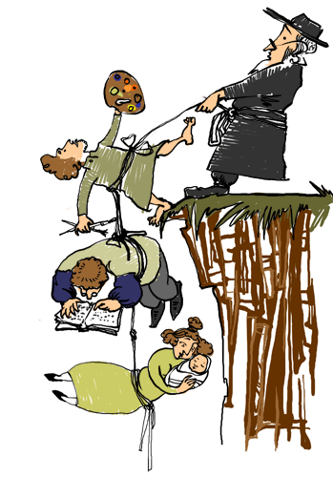
2. Authority & Responsibility

Slide 10
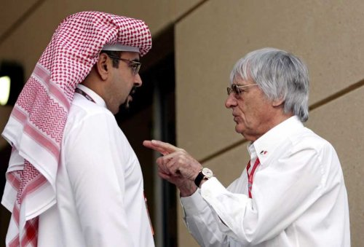
3. Unity of Command

Slide 11

4. Unity of Direction

Slide 12
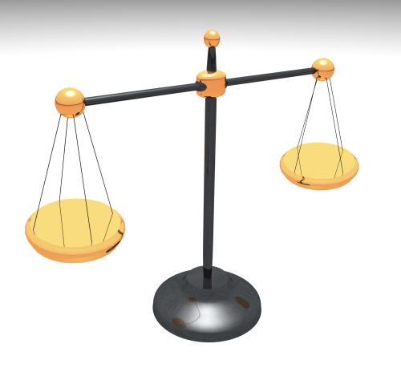
5. Equity

Slide 13

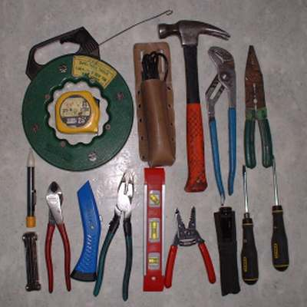
6. Order

Slide 14

7. Discipline

Slide 15
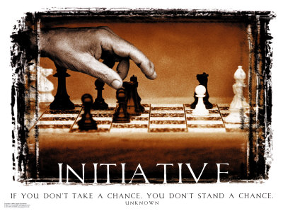
8. Initiative
Notes:
Initiative means eagerness to initiate actions without being asked to do so.
Management should provide opportunity to its employees to suggest ideas, experiences& new method of work.

Slide 16

9. Remuneration

Slide 17

10. Stability of Tenure

Slide 18
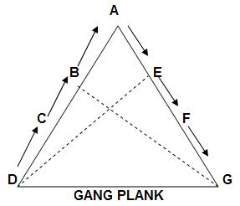
11. Scalar Chain

Slide 19

12. Sub-Ordination of Individual Interest to common goal

Slide 20

13. Espirit De’ Corps

Slide 21

14. Centralization

Slide 22
1. Specialization of labor. Specializing encourages continuous improvement in skills and the development of improvements in methods.
2. Authority. The right to give orders and the power to exact obedience.
3. Discipline. No slacking, bending of rules.
4. Unity of command. Each employee has one and only one boss.
5. Unity of direction. A single mind generates a single plan and all play their part in that plan.
6. Subordination of Individual Interests. When at work, only work things should be pursued or thought about.
7. Remuneration. Employees receive fair payment for services, not what the company can get away with.

Slide 23
8. Centralization. Consolidation of management functions. Decisions are made from the top.
9. Scalar Chain (line of authority). Formal chain of command running from top to bottom of the organization, like military
10. Order. All materials and personnel have a prescribed place, and they must remain there.
11. Equity. Equality of treatment (but not necessarily identical treatment)
12. Personnel Tenure. Limited turnover of personnel. Lifetime employment for good workers.
13. Initiative. Thinking out a plan and do what it takes to make it happen.
14. Esprit de corps. Harmony, cohesion among personnel.

Slide 24
The Bureaucratic Organization
Max Weber (1864–1920)
  An ideal, intentionally rational, and very efficient form of organization.
  Based on principles of logic, order, and legitimate authority.
  Goals of the bureaucratic model:

Slide 25
The Bureaucratic Organization:
Characteristics of bureaucratic organizations:
  Clear division of labor
  Clear hierarchy of authority
  Formal rules and procedures
  Impersonality
  Careers based on merit
Possible disadvantages of bureaucracy:
  Excessive paperwork or “red tape”
  Slowness in handling problems
  Rigidity in the face of shifting needs
  Resistance to change
  Employee apathy

Slide 26
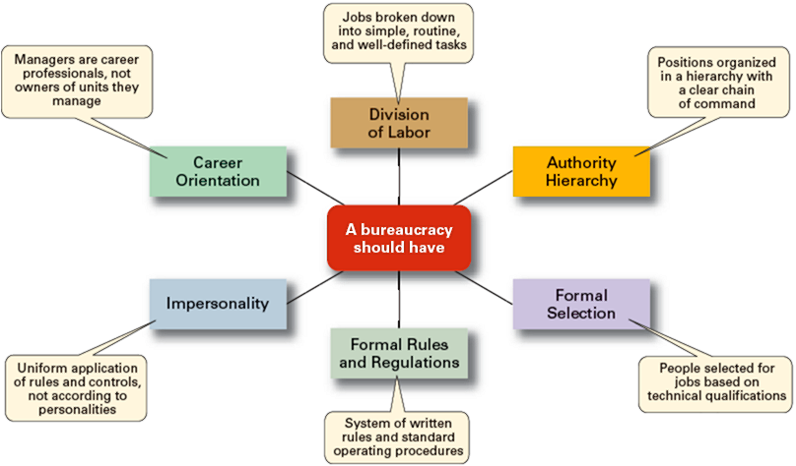
Weber’s Ideal Bureaucracy

Slide 27
The Bureaucratic Organization
Amazon.com
Pepsi-Cola
IRS
Cisco Systems
Procter & Gamble
Blockbuster
Video
Starbucks
Sony
McDonald’s
Low
Bureaucratic
Structure
High
Bureaucratic
Orientation
Mid-Range
Bureaucracy

Slide 28
Behavioral management approaches:
Hawthorne Studies
----------------------
Elton Mayo
Theory of Human Needs
----------------------
Abraham Maslow
Theory X &Theory Y
--------------------------
Douglas McGregor
Personality & Organization
----------------------
Mary Parker Follett
HUMAN RESOURCE APPROACH
---------------------------------
Assumption: People are social and self actualization

Slide 29
Behavioral management Approaches: Elton Mayo
Conducted the famous Hawthorne Experiments.
  “Hawthorne Effect”
    Productivity increased because attention was paid to the workers in the experiment.
    Phenomenon whereby individual or group performance is influenced by human behavior factors.
His work represents the transition from scientific management to the early human relations movement.

Slide 30
Mayo's Hawthorne Experiments
George Elton Mayo was in charge of certain experiments on human behavior carried out at the Hawthorne Works of the General Electric Company in Chicago between 1924 and 1927.
His research findings have contributed to organization development in terms of human relations and motivation theory

Slide 31
The findings of these investigations he came to certain conclusions as follows
>Work is a group activity.
>The need for recognition, security and sense of belonging is more important in determining workers' morale and productivity than the physical conditions under which he works.
>The worker is a person whose attitudes and effectiveness are conditioned by social demands from both inside and outside the work plant.
>Informal groups within the work plant exercise strong social controls over the work habits and attitudes of the individual worker.

Slide 32
Variables Affecting Productivity
Mayo took six women from the assembly line, segregated them from the rest of the factory and put them under the eye of a supervisor who was more a friendly observer than disciplinarian. Mayo made frequent changes in their working conditions, always discussing and explaining the changes in advance.
He changed the hours in the working week, the hours in the workday the number of rest breaks. the time of the lunch hour. Occasionally, he would return the women to their original, harder working conditions.

Slide 33
Relay Assembly
The investigators selected two girls for their second series of experiments and asked them to choose another four girls, thus making a small group of six. The group was employed in assembling telephone relays - a relay being a small but intricate mechanism composed of about forty separate parts which had to be assembled by the girls seated at a lone bench and dropped into a chute when completed.

Slide 34
The relays were mechanically counted as they slipped down the chute. It was intended that the basic rate of production should be noted at the start, and that subsequently changes would be introduced, the effectiveness of which would be measured by increased or decreased production of the relays.

Slide 35
Feedback mechanism
Through out the series of experiments, an observer sat with the girls in the workshop noting all that went on, keeping the girls informed about the experiment, asking for advice or information, and listening to their complaints. The experiment began by introducing various changes, each of which was continued for a test period of four to twelve weeks. The results of these changes are as follows

Slide 36
Conditions and results
Under normal conditions with a forty eight hour week, including Saturdays, and no rest pauses. The girls produced 2,400 relays a week each.

Slide 37
They were then put on piece-work for eight weeks.
Output went up
Two five minute rest pauses, morning and afternoon, were introduced for a period of five weeks.
Output went up once more
The rest pauses were lengthened to ten minutes each.
Output went up sharply.
Six five minute pauses were introduced, and the girls complained that their work rhythm was broken by the frequent pauses.
Output fell slightly
Return to the two rest pauses, the first with a hot meal supplied by the Company free of charge.
Output went up

Slide 38
The girls were dismissed at 4.30 p.m. instead of 5.00 p.m.
Output went up
They were dismissed at 4.00 p.m.
Output remained the same
Finally, all the improvements were taken away, and the girls went back to the physical conditions of the beginning of the experiment: work on Saturday, 48 hour week, no rest pauses, no piece work and no free meal. This state of affairs lasted for a period of 12 weeks.
Output was the highest ever recorded averaging 3000 relays a week

Slide 39
What happened during the experiments
What happened was that six individuals became a team and the team gave itself wholeheartedly and spontaneously to co-operation in the experiment. The consequence was that they felt themselves to be participating freely and without afterthought and were happy in the knowledge that they were working without coercion from above or limitation from below

Slide 40
They were themselves satisfied at the consequence for they felt that they were working under less pressure than ever before. In fact regular medical checks showed no signs of cumulative fatigue and absence from work declined by 80 per cent.
It was noted too, that each girl had her own technique of putting the component parts of the relay together - sometimes she varied this technique in order to avoid monotony and it was found that the more intelligent the girl, the greater was the number of variations

Slide 41
The experimental group had considerable freedom of movement. They were not pushed around or bossed by anyone. Under these conditions they developed an increased sense of responsibility and instead of discipline from higher authority being imposed, it came from within the group itself.

Slide 42
The findings
To his amazement, Elton Mayo discovered a general upward trend in production, completely independent of any of the changes he made.
His findings didn't mesh with the then current theory (see F.W. Taylor) of the worker as motivated solely by self-interest. It didn't make sense that productivity would continue to rise gradually when he cut out breaks and returned the women to longer working hours.

Slide 43
Mayo began to look around and realized that the women, exercising a freedom they didn't have on the factory floor, had formed a social atmosphere that also included the observer who tracked their productivity. The talked, they joked. they began to meet socially outside of work
Mayo had discovered a fundamental concept that seems obvious today. Workplaces are social environments and within them, people are motivated by much more than economic self-interest He concluded that all aspects of that industrial environment carried social value

Slide 44
When the women were singled out from the rest of the factory workers, it raised their self-esteem. When they were allowed to have a friendly relationship with their supervisor. they felt happier at work. When he discussed changes in advance with them, they felt like part of the team.
He had secured their cooperation and loyalty; it explained why productivity rose even when he took away their rest breaks.

Slide 45
The Hawthorne Effect at Work
Suppose you've taken a management trainee and given her specialized training in management skills she doesn't now possess. Without saving a word, you've given the trainee the feeling that she is so valuable to the organization that you'll spend time and money to develop her skills. She feels she's on a track to the top, and that motivates her to work harder and better. The motivation is independent of any particular skills or knowledge she may have gained from the training session. That's the Hawthorne Effect at work.

Slide 46
The Hawthorne Studies
A series of productivity experiments conducted at Western Electric from 1927 to 1932.
Experimental findings
  Productivity unexpectedly increased under imposed adverse working conditions.
  The effect of incentive plans was less than expected.
Research conclusion
  Social norms, group standards and attitudes more strongly influence individual output and work behavior than do monetary incentives.

Slide 47
Behavioral Management Theory:Mary Parker Follett
A key to effective management was coordination.
Felt that managers needed to coordinate & harmonize group effort rather than force & coerce people.
Believed that management is a continuous, dynamic process.
Felt that the best decisions would be made by people who were closest to the situation.
  This is the heart of the Toyota Production System (TPS)
Notes:
The study of how managers should behave in order to motivate employees to achieve organizational goals.

Slide 48
Behavioral management approaches:
Maslow’s theory of Human Needs

Slide 49


Physiological Needs
Basic Human Needs
Food
Air
Water
Clothing

Slide 50
Safety Needs
Safety and Security
Protection
Stability
Pain Avoidance
Routine/Order

Slide 51

Social Needs
Love and Belonging
Affection
Acceptance
Inclusion

Slide 52

Esteem Needs
Esteem
Self-Respect
Self-Esteem
Respected by Others

Slide 53

Self-Actualization
Achieve full potential
Fulfillment

Slide 54
Meeting Needs in the Classroom???

Slide 55
Implementing in the Classroom
Self-Actualization | Provide challenges Encourage autonomy
Esteem | Feedback Acknowledge success
Social | Introductions Interact with students Inclusive activities
Safety | Maintain a safe and non-threatening atmosphere Create a comfortable environment
Physiological | Room temperature Pacing/Breaks

Slide 56
Behavioral management Approaches: Douglas McGregor
Proposed the Theory X and Theory Y styles of management.
  Theory X managers perceive that their subordinates have an inherent dislike of work and will avoid it if at all possible.
  Theory Y managers perceive that their subordinates enjoy work and that they will gain satisfaction from performing their jobs.

Slide 57
Comparison: Theory X & Theory Y Assumptions
Factor Theory X Assumptions Theory Y Assumptions
Employee attitude Employees dislike work and. Employees enjoy work and
toward work will avoid it if at all possible. will actively seek it.
Management view Employees must be directed, Employees are self-motivated
of direction coerced, controlled, or threatened and self-directed toward achieving
to get them to put forth adequate effort. organizational goals.
Employee view Employees wish to avoid responsibility; Employees seek responsibility;
of direction they prefer to be directed and told what they wish to use their creativity,
to do and how to do it. imagination, and ingenuity in
performing their jobs.
Management style Authoritarian style of management Participatory style of management

Slide 58
Modern Management Thinking:
CONTEMPORARY APPROACH
Learning organizations
Total Quality Management
Contingency thinking
Systems view of organizations

Slide 59
Modern Management Thinking:
Systems thinking
  System
    Collection of interrelated parts that function together to achieve a common purpose.
  Subsystem
    A smaller component of a larger system.
  Open systems
    Organizations that interact with their environments in the continual process of transforming resource inputs into outputs.

Slide 60
The Organization as an Open System
ENVIRONMENT
Input Stage
Conversion Stage
Output Stage
Raw Materials
Money & Capital
Human resources
Goods & Services
Financial results
Information
Human results
Machinery
Computers
Human Skills
Organization obtains inputs from environment
Organization transforms inputs & add values to them
Organization releases its outputs to environment
Sales of outputs allow organization to obtain new supplies of input

Slide 61
Implications of the Systems Approach
Coordination of the organization’s parts is essential for proper functioning of the entire organization.
Decisions and actions taken in one area of the organization will have an effect in other areas of the organization.
Organizations are not self-contained and, therefore, must adapt to changes in their external environment.

Slide 62
Modern Management Thinking:
Contingency thinking
  Tries to match managerial responses with problems and opportunities unique to different situations.
  No “one best way” to manage.
  Appropriate way to manage depends on the situation.

Slide 63
Contingency Viewpoint
Behavioral Viewpoint
How managers influence others:
Informal Group
Cooperation among employees
Employees’ social needs
Systems Viewpoint
How the parts fit together:
  Inputs
  Transformations
  Outputs
Traditional Viewpoint
What managers do:
  Plan
  Organize
  Lead
  Control
Contingency Viewpoint
Managers’ use of other viewpoints
to solve problems involving:
  External environment
  Technology
  Individuals

Slide 64
The Contingency Approach
Contingency Approach Defined
  Also sometimes called the situational approach.
  There is no one universally applicable set of management principles (rules) by which to manage organizations.
  Organizations are individually different, face different situations (contingency variables), and require different ways of managing.

Slide 65
Modern Management Thinking:
Quality and performance excellence
  Managers and workers in progressive organizations are quality conscious.
  Total quality management (TQM)
Quality and performance excellence
  ISO certification
  Continuous improvement
  Quality circle

Slide 66
Modern Management Thinking:
Learning organizations
  Organizations that are able to continually learn and adapt to new circumstances.
  Core ingredients include:
    Mental models
    Personal mastery
    Systems thinking
    Shared vision
    Team learning

